Slide 1


AI-Based System for 5 Categories Fungus Detection
A 4-Phase Experimental Journey to a High-Accuracy Deployed Model
By
Hothifa Sadiq
Ahmed Essam
Suhail Kamel
Yaseen Al-Hammadi
Khalil Hadi
Under the Supervision of
Dr. Ayman Al-Sabri
2026

Slide 2

Table of Contents
01
Introduction
02
Research Methodology
03
Model Training & Evaluation
04
System Implementation
05
Conclusion & Future Work

Slide 3

01 Introduction
Background
Fungal infections are a significant global health challenge. The traditional, conventional methods for diagnosing them are often slow and, unfortunately, can be inaccurate.
A delayed or inaccurate diagnosis isn't just an inconvenience; it can lead to serious complications and make treatment much more difficult. This highlights an urgent need for more modern and effective solutions.
Project Vision
This project aims to design and develop an
AI-based system for detecting fungal infections
through the analysis of medical
images. By integrating the AI inference model with a Flutter-based mobile application and Flask middleware server, the system
provides an
accessible, real-time diagnostic tool
for healthcare professionals.

Slide 4

Motivation & Problem Statement
Motivation
Problem Statement
Global Health Challenge
Inaccurate Diagnosis
Fungal infections affect millions worldwide and are often difficult to diagnose accurately using conventional methods.
Traditional methods often lead to inaccurate results due to human error or limitations in available medical resources.
Diagnostic Delays
Time Constraints
Traditional diagnostic methods require specialized laboratory tests and considerable time, leading to delayed treatment and increased complications.
Patients may not receive immediate or precise diagnoses, which delays treatment and increases risk of complications.
AI Advancement
Resource Limitations
Deep learning has demonstrated exceptional capability in medical image analysis, enabling rapid and accurate disease detection.
Limited access to specialized diagnostic equipment and expertise in many healthcare settings worldwide.
Accessibility Gap
Solution Need
There is an urgent need for advanced tools that can assist medical professionals in identifying fungal infections quickly and reliably.
Many regions lack access to specialized dermatologists, making an accessible AI diagnostic tool essential for healthcare equity.

Slide 5
Project Objectives
Main Objective
Design and develop an intelligent, cloud-enabled system that can accurately detect and analyze fungal infections in the human body using Artificial Intelligence (AI) techniques.
Specific Objectives
1
Collect and preprocess medical image datasets related to fungal infections, ensuring data quality and balance across five distinct classes (H1, H2, H3, H5, H6).
2
Evaluate and select the optimal deep learning model through rigorous experimentation with multiple CNN architectures and advanced techniques.
3
Integrate cloud-based deep learning inference through the Hugging Face URL for accurate, scalable fungal image classification.
4
Design a Flutter-based mobile application that allows users and healthcare professionals to upload and analyze images easily.
5
Implement a Flask middleware server to manage API communication, image preprocessing, and orchestration between mobile app and cloud AI.
6
Evaluate system performance in terms of response time, scalability, diagnostic accuracy, and user experience in real-world scenarios.

Slide 6
Scope of Study
Primary Focus
This study focuses on applying Artificial Intelligence and cloud computing in medical image analysis for fungal infection
detection. The project emphasizes scalability, cost-efficiency, and accessibility through cloud-based inference and mobile technology.
Inclusions
Exclusions & Limitations
•
Dataset preparation and preprocessing (5 fungal classes: H1, H2, H3, H5, H6)
•
The system provides diagnostic support only
•
Not a replacement for professional medical expertise
•
Evaluation of multiple deep learning architectures
•
Does not prescribe treatment or medications
•
Model integration via Hugging Face cloud API
•
Requires stable internet connection for cloud inference
•
Flutter-based mobile application development
•
Flask middleware server implementation
•
System performance and scalability evaluation

Slide 7

Literature Review: State-of-the-Art Fungi Classification
Recent advances in deep learning have significantly improved fungal classification accuracy. The following table presents a comprehensive review of state-of-the-art research in this field, demonstrating the rapid progression of accuracy metrics and the effectiveness of advanced architectures.
Rank
Research / Model
Architecture / Approach
Test Accuracy (%)
Year / Status
1
Transformer Ensemble (5-fold CV)
2026 (Current)
Our Project: SwinV2-Base Ensemble
98.61
2
Swin Transformer
Vision Transformer with Shifted Windows
98.36
2024
3
VGG19DeFungi
VGG19 with Custom Augmentation
97.00
2023
4
VGG16 with Augmentation
VGG16 with Advanced Preprocessing
97.19
2022
5
MeFunX
Multi-Scale Feature Extraction
92.49
2021
6
Vision Transformer (ViT)
Pure Transformer Architecture
90.13
2020
→ Next: Key insights on Transformer dominance, our achievement, rapid advancement, and augmentation impact

Slide 8


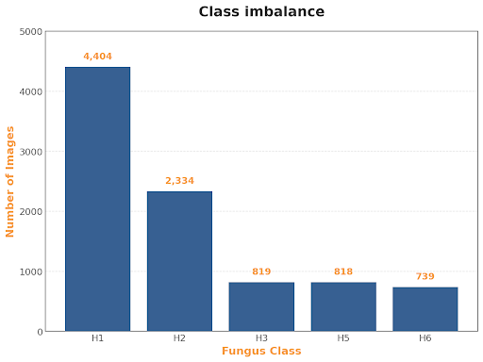
Dataset:
Dataset Details:
Name: DeFungi Dataset
Source: UCI Machine Learning Repository
Total Images: 9,114
Classes:
5 distinct categories, manually labeled by experts
  H1: Candida albicans
  H2: Aspergillus Niger
  H3: Trichophyton rubrum
  H5: Trichophyton mentagrophytes
  H6: Epidermophyton floccosum

Slide 9
Dataset Samples:
  H1: Candida albicans
  H2: Aspergillus Niger
  H3: Trichophyton rubrum
  H5: Trichophyton mentagrophytes
  H6: Epidermophyton floccosum

Slide 10

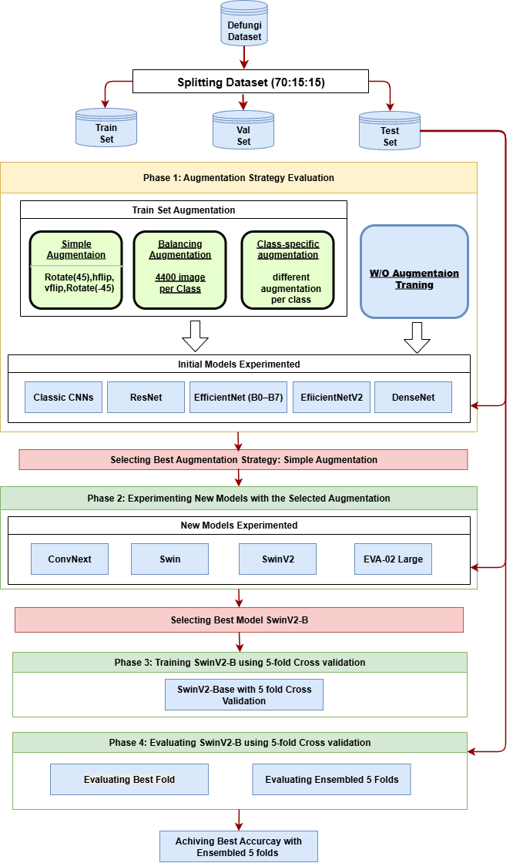
Research Methodology: 4-Phase Approach

Slide 11
Research Methodology: 4-Phase Approach

Slide 12
Research Methodology: 4-Phase Approach

Slide 13
Research Methodology: 4-Phase Approach

Slide 14
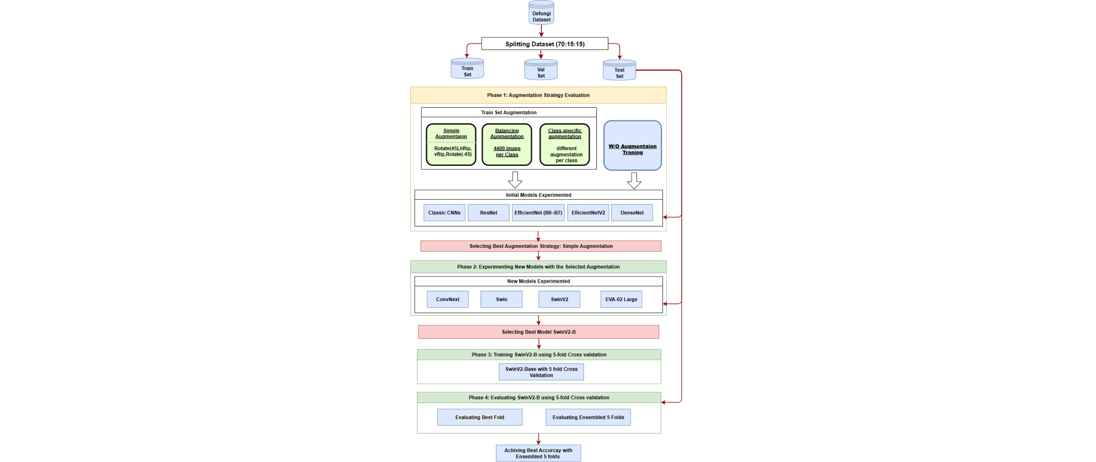
Research Methodology: 4-Phase Approach
This project adopts an
Agile Software Development Model
with a rigorous
4-phase approach
for model evaluation
and selection. The methodology ensures systematic evaluation of augmentation strategies, model architectures, and
optimization techniques to identify the optimal solution for microscopic fungi classification.

Slide 15

Phase 1: Augmentation Strategies Evaluated
Four Augmentation Strategies Compared
1
2
Simple Augmentation
Balancing Augmentation
Rotate(45), horizontal flip, vertical flip, Rotate(-45). Introduces basic variability in orientation and flipping while maintaining computational efficiency.
Generated 4400 images per class to address class imbalance and ensure balanced training distribution across all five fungal classes.
3
4
Class-specific Augmentation
W/O Augmentation
Different augmentation techniques applied to each class individually for specialized feature extraction tailored to unique morphological characteristics.
Training without any augmentation techniques to establish baseline performance and understand the contribution of augmentation strategies.
→ Next: Evaluation across CNN architectures and Phase 1 results

Slide 16
Phase 1: Models & Results
CNN Architectures Tested Across All Augmentation Strategies
Classic CNNs
ResNet
EfficientNet (B0-B7)
EfficientNetV2
DenseNet
Phase 1 Result: Optimal Strategy Selected
After comprehensive evaluation of all four augmentation strategies across multiple CNN architectures,
Simple Augmentation was identified as the optimal strategy for the fungi dataset. This strategy provides an effective
balance between data variability and computational efficiency, achieving superior performance across all tested CNN
architectures while maintaining practical training times.
✓ Simple Augmentation Selected

Slide 17

Phase 2: New Model Experimentation
Methodology
All new models were trained using the Simple Augmentation strategy selected from Phase 1. This ensures consistent
evaluation cross advanced architectures while maintaining the optimal augmentation approach identified in the previous phase.
Advanced Architectures Tested
ConvNext
Swin
SwinV2
EVA-02 Large
Modern CNN architecture with improved efficiency and accuracy compared to traditional ResNets.
Shifted Window Transformer architecture introducing hierarchical vision transformers.
Improved version of Swin with enhanced training stability and performance.
Large-scale vision model with advanced feature extraction capabilities.
Phase 2 Result: SwinV2-Base Selected
SwinV2-Base was identified as the best-performing model among all tested advanced architectures. Its superior performance in capturing both local and global features from microscopic fungi images, combined with computational efficiency, made it the optimal choice for further optimization through 5-fold cross validation in Phase 3 & 4.
✓ Best Performer Selected

Slide 18

Phase 3: SwinV2-B Training with 5-Fold Cross Validation
3
Training Phase Overview
•
Model Selected:
SwinV2-Base (from Phase 2)
•
Strategy:
5-Fold Cross Validation
•
Process:
Dataset divided into 5 folds, model trained on each fold combination
•
Objective:
Generate diverse models for ensemble creation
•
Output:
5 trained SwinV2-B models from different data splits
5-Fold Cross Validation Methodology
The dataset is divided into
5 equal folds
. For each iteration, one fold is held out as the validation set while the remaining 4 folds are used for training. This process
repeats 5 times, ensuring each fold is used as both training and validation data.
Fold 1
Fold 2
Fold 3
Fold 4
Fold 5
→ Next: Phase 4 - Evaluation of best individual fold and ensemble results

Slide 19

Phase 4: Evaluation & Ensemble Results
Evaluation Methodology
Evaluation 1: Best Individual Fold (TTA)
Evaluation 2: Ensemble Voting
Test-Time Augmentation applied to the best performing fold from the 5-fold cross-validation. Multiple augmented versions of test images are generated and averaged for final prediction.
All 5 trained models vote on each prediction. Final class is determined by majority voting mechanism across all 5 folds, leveraging model diversity for robustness.
Performance Metrics Comparison
Evaluation Method
Accuracy
Precision (W. Avg)
Recall (W. Avg)
F1-Score (W. Avg)
Best Fold (TTA)
98.03%
0.9804
0.9803
0.9803
Ensemble (5 Folds)
98.61%
0.9862
0.9861
0.9861
Key Finding: Ensemble Superiority
The
ensemble approach achieved 98.61% accuracy
, outperforming the best individual fold by
0.58%
This demonstrates the power of model ensembling in leveraging the diversity of models trained on different data splits to create a highly robust and generalizable final predictor for fungal classification.

Slide 20

Consolidated Model Performance Comparison
Model (Variant)
Training Setup
Input Res.
Test Accuracy (%)
Precision (W. Avg)
Recall (W. Avg)
F1-Score (W. Avg)
Key Insight
SwinV2-Base Ensemble
PyTorch (5-Fold Ensemble)
384×384
98.61
0.9862
0.9861
0.9861
Overall Leader: Transformer + Ensembling
SwinV2-Base (Best Fold TTA)
PyTorch (TTA Applied)
384×384
98.03
0.9804
0.9803
0.9803
Best single model with TTA
EfficientNetV2-M (in21k)
PyTorch (Advanced Aug.)
384×384
96.71
0.9675
0.9671
0.9672
Best CNN performance
VGG19
PyTorch (MixUp/CutMix)
224×224
95.33
0.9535
0.9533
0.9532
High performance at lower resolution
DenseNet201
TensorFlow/Keras (Baseline)
224×224
94.23
0.94
0.94
0.94
Highest Keras baseline
EfficientNetB3
TensorFlow/Keras (Baseline)
224×224
95.11
0.95
0.95
0.95
Competitive baseline
SwinV2-Base (Full Train/Val)
PyTorch (TTA Applied)
384×384
98.39
0.9840
0.9839
0.9839
Strong ensemble variant
EfficientNetB0(2)(1)
TensorFlow/Keras (Baseline)
224×224
91.75
0.92
0.91
0.93
Competitive baseline
ConvNeXtTiny
TensorFlow/Keras (Baseline)
224×224
91.82
0.92
0.92
0.92
Baseline performance
EfficientNetB5
TensorFlow/Keras (2-stage)
224×224
77.00
0.77
0.77
0.77
Lowest performance
Best Performer (98.61%)
Top Performers (>95%)

Slide 21

Best Performer: SwinV2-Base Ensemble
98.61%
Test Accuracy
Precision:
0.9862
Recall:
0.9861
F1-Score:
0.9861
Project Achievement
The
SwinV2-Base Ensemble model
represents the culmination of our rigorous 4-phase methodology, achieving exceptional performance in fungal
infection classification. This
98.61% test accuracy
demonstrates the effectiveness of combining advanced deep learning architectures with
sophisticated optimization techniques and model ensembling strategies.
→ Next: Key factors contributing to this superior performance

Slide 22

Key Factors for Superior Performance
1
Transformer Architecture
2
High-Resolution Input
SwinV2's shifted window mechanism effectively captures both local and global features in microscopic images, enabling superior feature extraction compared to traditional CNNs.
Training on 384×384 pixel images (vs. standard 224×224) allows the model to capture finer details and morphological characteristics of fungal structures.
✓ Hierarchical feature learning with reduced computational complexity
✓ Preserves critical microscopic details for accurate classification
3
Advanced Regularization
4
Model Ensembling
MixUp/CutMix augmentation combined with Automatic Mixed Precision (AMP) training enhances model robustness and prevents overfitting while improving computational efficiency.
Leveraging the diversity of 5-fold cross-validation models creates a highly robust final predictor by combining predictions from multiple independently trained models.
✓ Improved generalization and faster training without accuracy loss
✓ Ensemble voting reduces individual model biases (+0.58% accuracy gain)

Slide 23

SwinV2-Base Training Configuration: Framework & Input
Framework & Pre-training
Framework
PyTorch
with timm library
Pre-training
ImageNet-21k
weights
Model Variant
SwinV2-Base
Input Configuration
Input Resolution
384×384
pixels
Batch Size
32
Normalization
ImageNet statistics (mean: [0.485, 0.456, 0.406], std: [0.229, 0.224, 0.225])
→ Next: Training Parameters, Optimization, and Advanced Regularization Techniques

Slide 24

SwinV2-Base Training Configuration: Optimization & Regularization
Training Parameters
Optimization
Max Epochs
75
Optimizer
AdamW
Early Stopping
Triggered at epoch
48
(Patience: 15 epochs)
Learning Rate
5×10⁻⁵
(initial)
Loss Function
SoftTargetCrossEntropy
Weight Decay
0.05
LR Scheduler
Cosine Annealing
with 5-epoch warmup
Advanced Regularization Techniques
MixUp:
α = 0.8 — Blends pairs of training samples and their labels
CutMix:
α = 1.0 — Cuts and pastes patches between training images
Label Smoothing:
0.1 — Softens hard labels to improve generalization
Automatic Mixed Precision (AMP):
Enabled — Uses lower precision for efficiency while maintaining accuracy

Slide 25

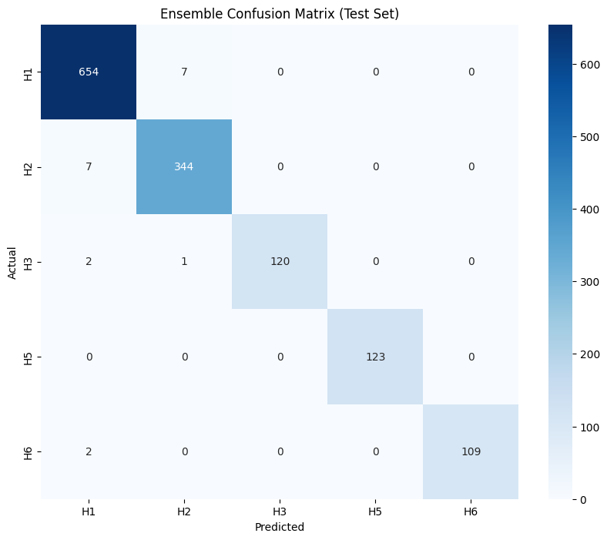
Common Challenge: H1 vs H2 Class Confusion
The Challenge
All models, including the best-performing SwinV2-Base Ensemble, struggled to differentiate between Classes H1 and H2 due to their morphological similarities. These two fungal species share many visual characteristics at the microscopic level, making them inherently difficult to distinguish.

Slide 26
Common Challenge: H1 vs H2 Class Confusion
Per-Class Performance (SwinV2 Ensemble)
Class
Precision
Recall
F1-Score
Support
H1
0.9803
0.9743
0.9773
155
Key Insight
The 0.2% performance gap between H1/H2 (F1: 0.977) and other classes (F1: 0.99+) indicates this is an inherent dataset limitation rather than a model deficiency. Future improvements require enhanced feature extraction or dataset augmentation strategies specifically targeting these classes.
H2
0.9744
0.9806
0.9775
154
H3
0.9918
0.9918
0.9918
122
H5
0.9915
0.9915
0.9915
118
H6
0.9921
0.9921
0.9921
127

Slide 27

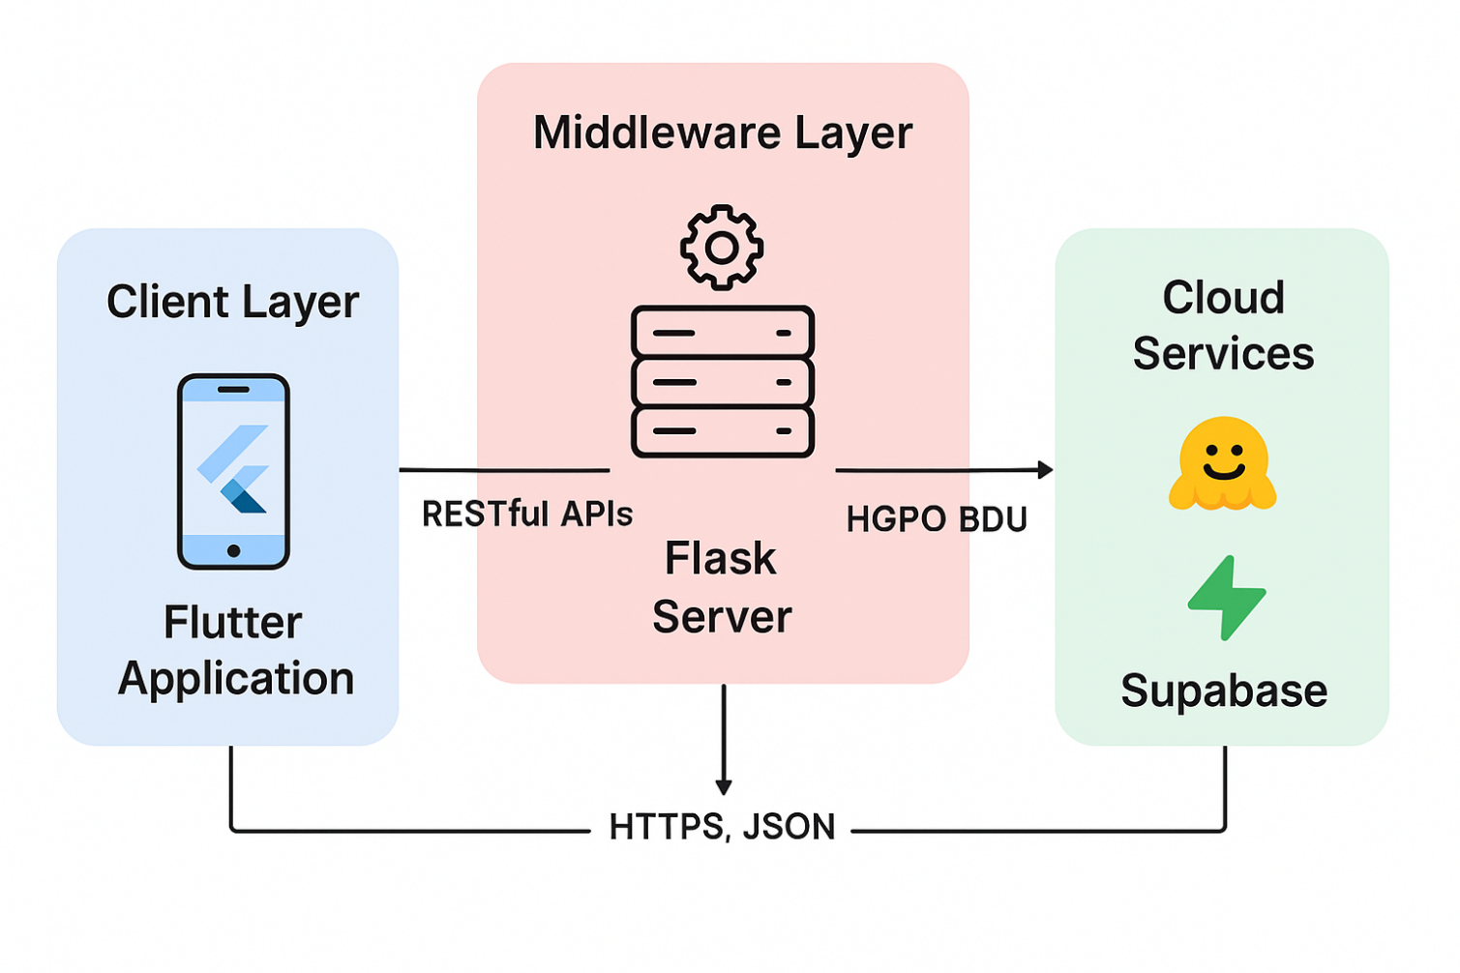
System Architecture Overview
📱
⚙️
🤖
💾
Flutter Mobile Application
Flask Middleware Server
Hugging Face Cloud Inference
Supabase Backend Services
Frontend / User Interface
Backend API / Orchestration
AI Model / Inference Engine
Database & Authentication

Slide 28

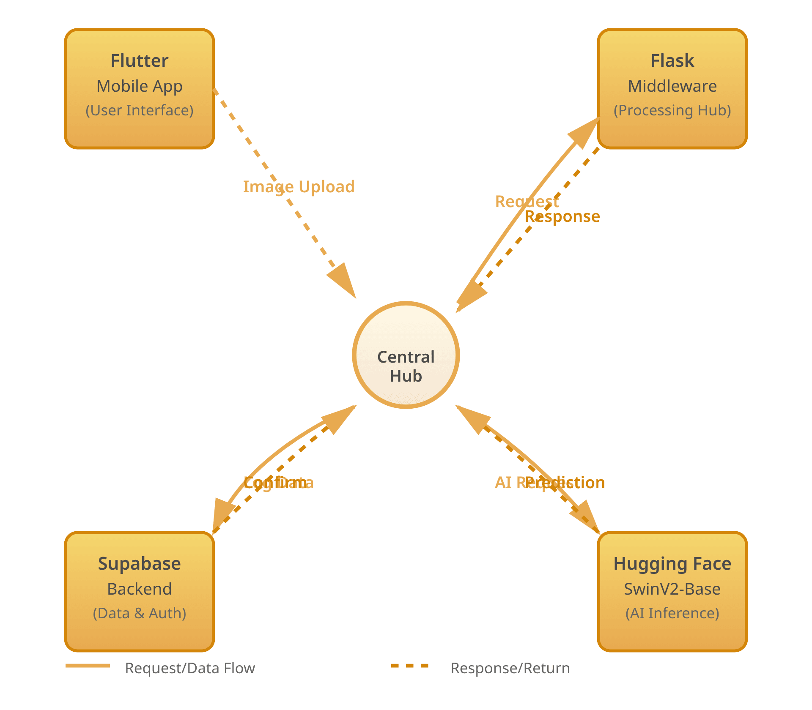




Integrated System Architecture: A Unified Diagnostic Pipeline
The system operates as a unified architecture that seamlessly connects the user interface, backend services, cloud-based AI inference, and data management components. By integrating Flutter, Flask, Hugging Face, and Supabase into a cohesive pipeline, the system delivers a scalable, reliable, and real-time diagnostic solution tailored for medical use cases.
1
Flutter Mobile App
Provides an intuitive interface for uploading medical images and initiating the diagnostic process.
2
Flask Middleware Server
Handles request processing, image preparation, and communication between the mobile front-end and cloud AI service.
3
SwinV2-Base Ensemble (Hugging Face)
Performs high-accuracy fungal classification and returns prediction results to the middleware.
4
Supabase Backend
Delivers secure authentication, user management, and storage of prediction history through PostgreSQL-backed services.

Slide 29

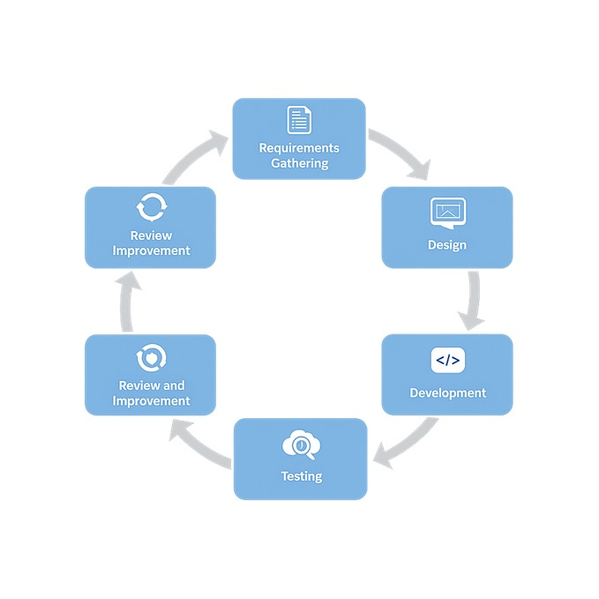
Agile Software Development Cycle

Slide 30


Future Work and Recommendations:
Improved Distinction: Develop advanced techniques (multi-task learning) to enhance precise differentiation between H1 and H2 categories.
Clinical Validation: Conduct large-scale validation studies in real clinical environments with hospitals and medical institutions.
Explainable AI (XAI): Integrate interpretability techniques (Grad-CAM, SHAP, attention visualization) to provide visual explanations of model predictions. Enhance clinician trust and enable better understanding of classification decisions.
→ Next: Clinical Validation in real-world healthcare settings and Explainable AI (XAI) integration with implementation roadmap

Slide 31




Project Conclusion: Intelligent Fungal Detection System
98.61% Accuracy
SwinV2-Base Ensemble model demonstrates strong reliability and consistent performance in fungal detection
System Architecture & Integration
The model has been successfully integrated into an easy-to-use mobile application, supported by a flexible cloud-based architecture using Hugging Face, Flask, and Supabase, making the system scalable and practical for real medical environments.
Hugging Face
Flask
Supabase
Flutter Mobile App
Healthcare Impact & Future Potential
The project showcases how advanced AI technologies can be effectively applied to medical diagnosis, providing faster and more accurate support for healthcare professionals. This intelligent system enables early detection and timely intervention in fungal infections.

